Slide 1

Bank Marketing Project

Slide 2

Business Problem and Goal
Find the best strategies to improve for the next marketing campaign. How can the financial institution have a greater effectiveness for future marketing campaigns? In order to answer this, we must analyze the last marketing campaign the bank performed and identify the patterns that will help us find conclusions in order to develop future strategies.

Slide 3
Dataset Introduction
Dataset Introduction: Bank Marketing Data Set
Size: 45211 x 17
45,211 rows (Data points)
17 features (16 independent and 1 dependent)
Programming Language: Python
Source: UCI Machine Learning Repository

Slide 4
Dataset Review
Age
Campaign
The minimum age of the bank’s client is 18 and maximum is 95 with the average of 40 years.
The maximum number of contacts made in the campaign to a single client is 63 while the minimum number of contacts is 1. The average number of contacts made was 2.76.
Balance
Passed Days
The mean customer balance is 1362.27, while the minimum balance is -8019 and maximum balance stands at 102127.
A maximum of 871 days passed by after a client was last contacted, while a minimum of -1 days passed by after a client was last contacted.
Duration
Previous Contact
The maximum duration in seconds of a single contact was 4918 seconds, while the shortest duration of a contact with a client lasted for 1 second.
A maximum of 275 contacts were made previously to a single client before the current campaign., while a minimum of 0 contacts were previously made.
Notes:
For Listings:- More than 70% of the listings are Apartments and rest other listings are entire homes, villa’s and etc.

Slide 5
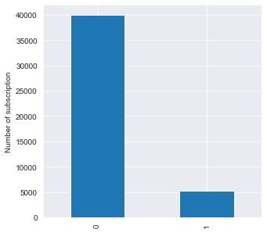
Target Variable
The target variable is binary.
It shows if the client has subscribed a term deposit or not.

Slide 6
What’s the process?
Removed nulls & outliers to clean the dataset
Dropped columns non relevant to our prediction
Used Standard-Scalar Library to normalize the data set
Logistics and Random Forest models
Data Cleaning
Feature Engineering
Standardizing
Predictive Analytics

Slide 7
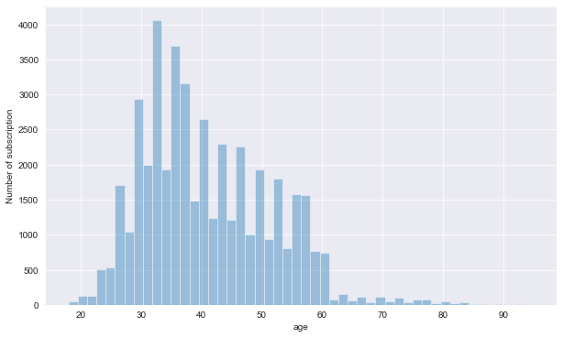
Exploratory Analysis

Slide 8
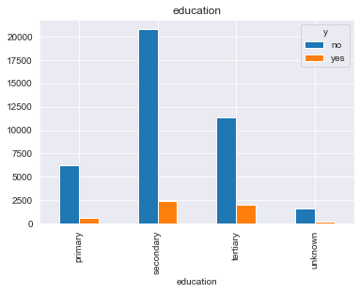
Exploratory Analysis

Slide 9
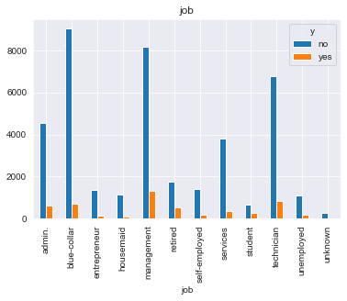
Exploratory Analysis

Slide 10
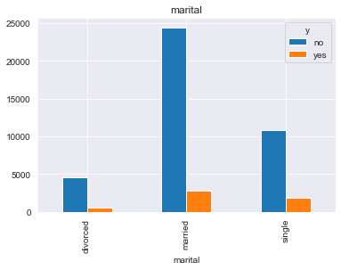
Exploratory Analysis

Slide 11
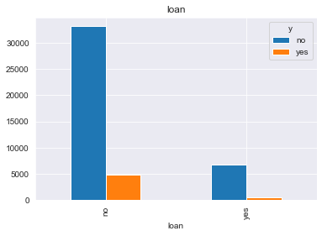
Exploratory Analysis

Slide 12
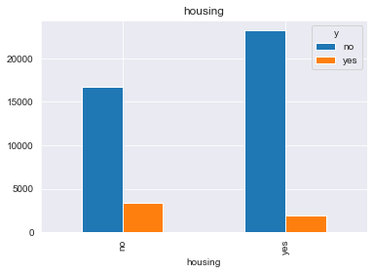
Exploratory Analysis

Slide 13
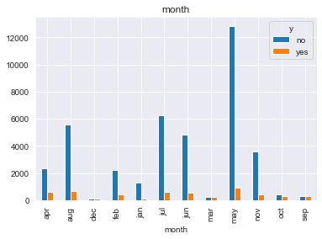
Exploratory Analysis

Slide 14
Pre-Processing Phase
Transform the categorial columns that have two level to binary feature
Transform the rest of categorical data to one-hot encoding (dummy-variables)
Normalize the numerical values:
𝑣𝑎𝑙𝑢𝑒_𝑛𝑜𝑟𝑚𝑎𝑙𝑖𝑧𝑒𝑑= (𝑣𝑎𝑙𝑢𝑒 − 𝑚𝑖𝑛)/ (max⁡− 𝑚𝑖𝑛)
Split to train and test sets with ratio of 70:30 respectively
Number of features after cleaning: 40
Training data size: 31,647
Test data size: 13,564

Slide 15
Models
2 models were implemented, evaluated and compared on this data.
Logistic Regression
Random Forest

Slide 16
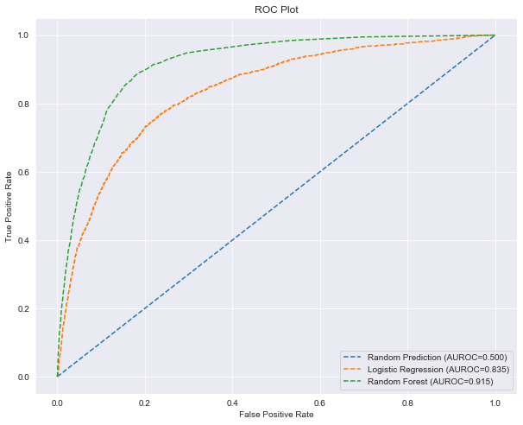
Receiver Operating Characteristic Curve

Slide 17
Model Comparison
Models | Accuracy | F1 score | AUC
Baseline | 50.00% | 50.00% | 0.5000
Random Forest | 90.29% | 88.23% | 0.915
Logistic Regression | 88.86% | 85.92% | 0.835

Slide 18
Confusion Matrix
Random Forest Confusion Matrix |  | Actual value
 |  | Positive | Negative | Total
Predicted value | Positive | 11,632 | 337 | 11,969
 | Negative | 969 | 626 | 1,595
 | Total | 12,601 | 963 | 13,564

Slide 19
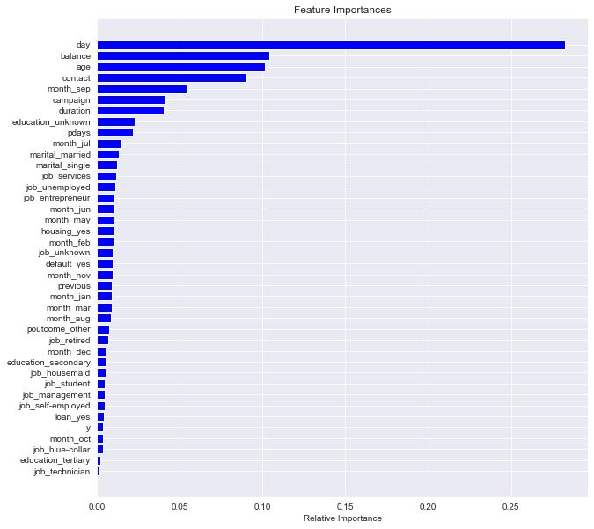
Feature Importance

Slide 20
Business Impact
By creating similar models, bankers can make an educated guess instead of choosing users randomly to call.
It will increase the success rate.
It will make the bank to have more prospects with fewer calls and faster.

Slide 21
THANKS

